Slide 1

Chapter 14.1 and 15
Page 446
Exploration and the Discovery of a New World

Slide 2
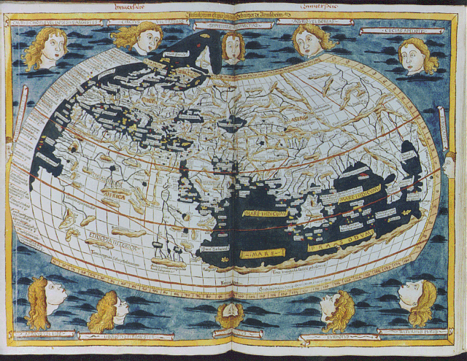
Map of the known world (1400s)

Slide 3
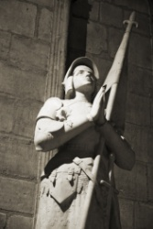
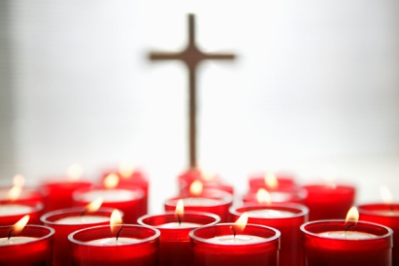



Motives for European Exploration
Crusades → by-pass middle-men to get to Asia.
Renaissance → curiosity about other lands and peoples.
Reformation → spreading Christianity
Monarchs seeking new sources of revenue
Technological advances
Fame and fortune

Slide 4
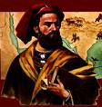
The Search for Spices
trade existed with Asia for centuries
learned of valuable goods from the travels of Marco Polo
found spices, silk, gold and other valuables
trade over land went through many middle-men which increased the price of goods
some countries began to try to reach Asia by sailing

Slide 5
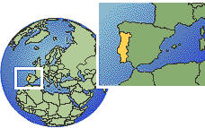
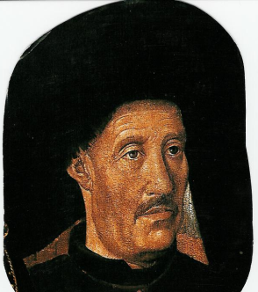
led by Prince Henry the Navigator, was the first country to explore
built navigation schools for sailors
used new technology
caravel ship (triangular sails, can go against the wind)
astrolabe, sextant and compass (for location and direction)

Slide 6
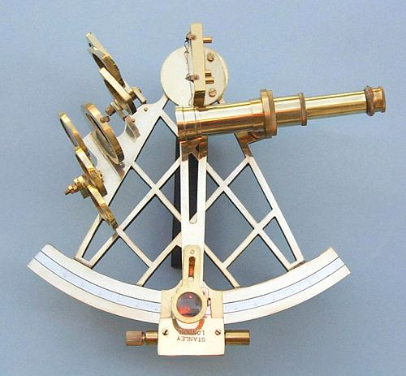
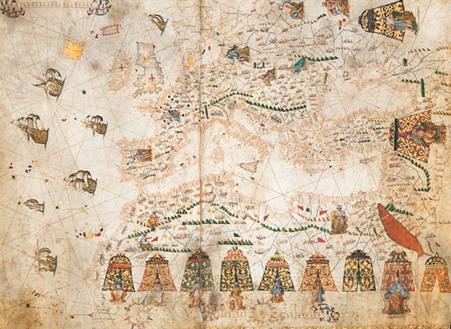
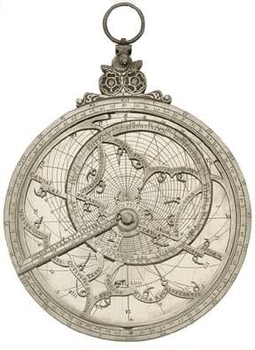
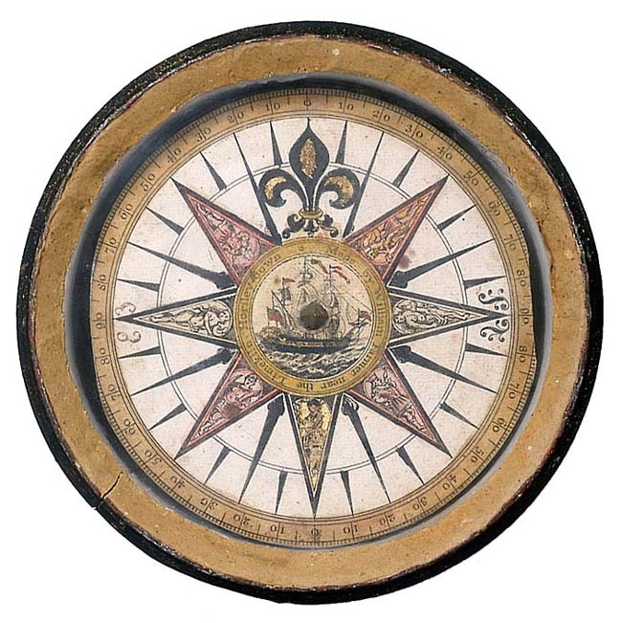
New Technologies
  Sextant
  Better Maps
  Astrolabe
  (1532)
  Mariner’s Compass

Slide 7
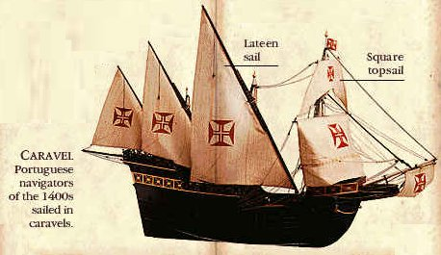
first traveled along the coast of Africa and traded with natives and made maps
1488, Bartholomeu Dias eventually cleared the bottom of Africa (The Cape of Good Hope)
1497, Vasco da Gama reaches India and finds trading partners
CARAVEL

Slide 8
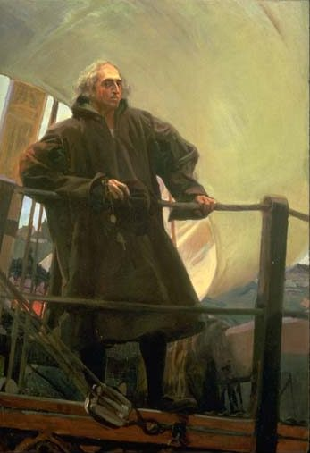
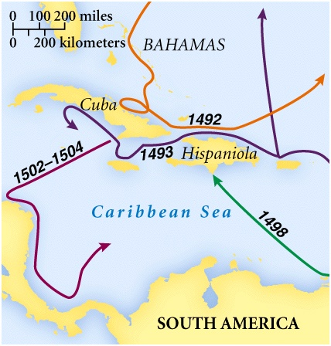
Spain starts Exploring
(from Italy) tries to reach Asia by sailing west
lands in the Bahamas but thinks he is in the East Indies (Asia)
calls the natives “Indians”
CHRISTOPHER COLUMBUS
4 Total Voyages

Slide 9

Other Explorers
The new world had been discovered, named “America” after Amerigo Vespucci (navigator who kept a journal and described the beauty of the land)
leads to more exploration in a new place
still searching for a northwest passage – shortcut to Asia through America
Ferdinand Magellan searches and travels around the whole world but no shortcut was found

Slide 10
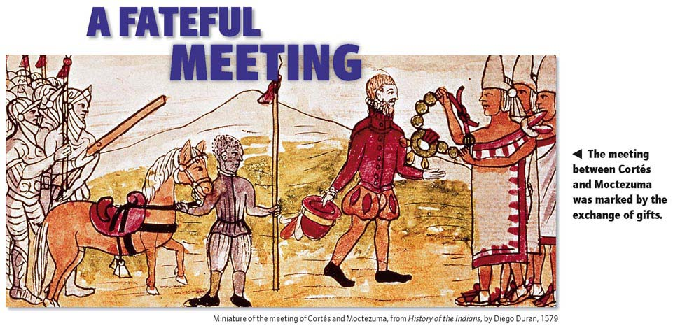
Chapter 15, Section 1 Pg. 471
Conquest of the Americas

Slide 11
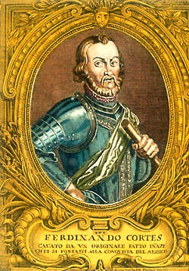
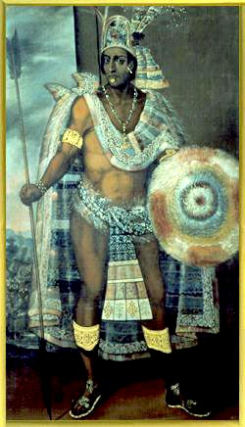
The First Spanish Conquests:
The Aztecs
vs.
Hernan Cortez
Montezuma II

Slide 12
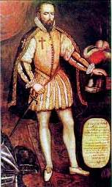
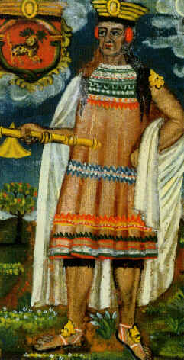
Conquistadors (Spanish Conquerors) enter the new world
attacks Tenochtitlan (Mexico City), the home of the Aztecs
gets help from neighboring tribes
takes over the Incas in South America
Spain now had many colonies and the most wealth in the world
Native Americans lose land and 90% of their population
vs.
Pizarro
Atahualpa
Hernan Cortes
Francisco Pizarro

Slide 13
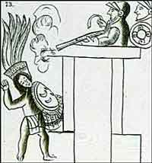
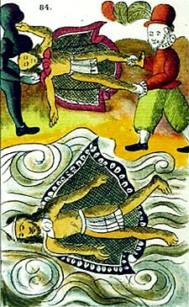
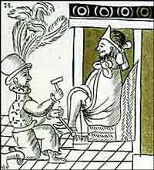
The Death of Montezuma II

Slide 14
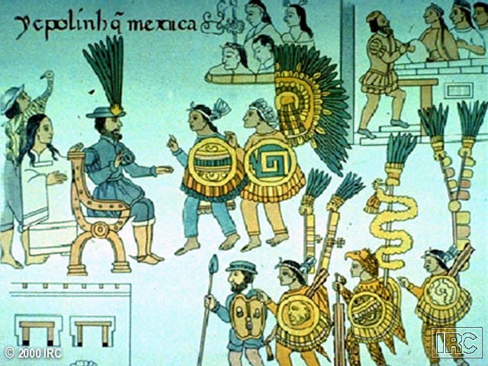
Mexico Surrenders to Cortez

Slide 15
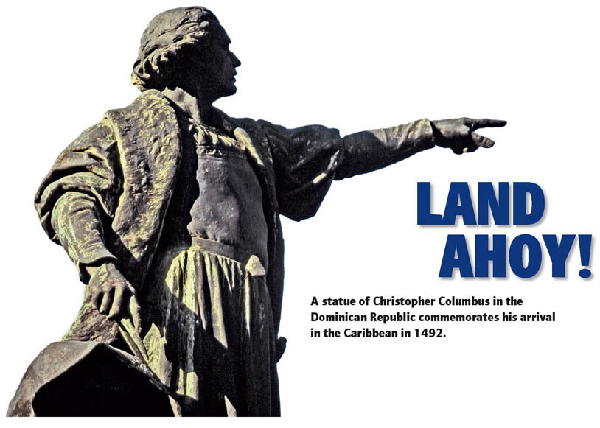
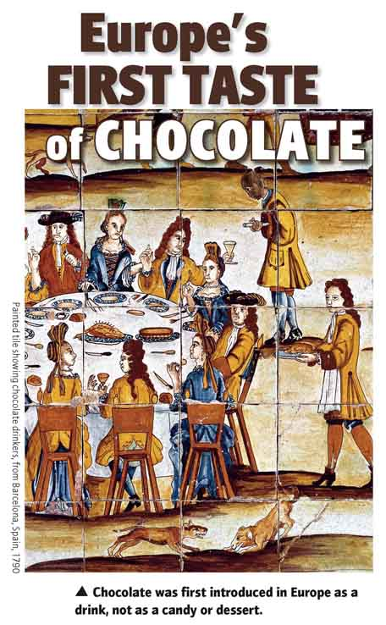
Section 2 Page 477
Spanish Colonies of America

Slide 16
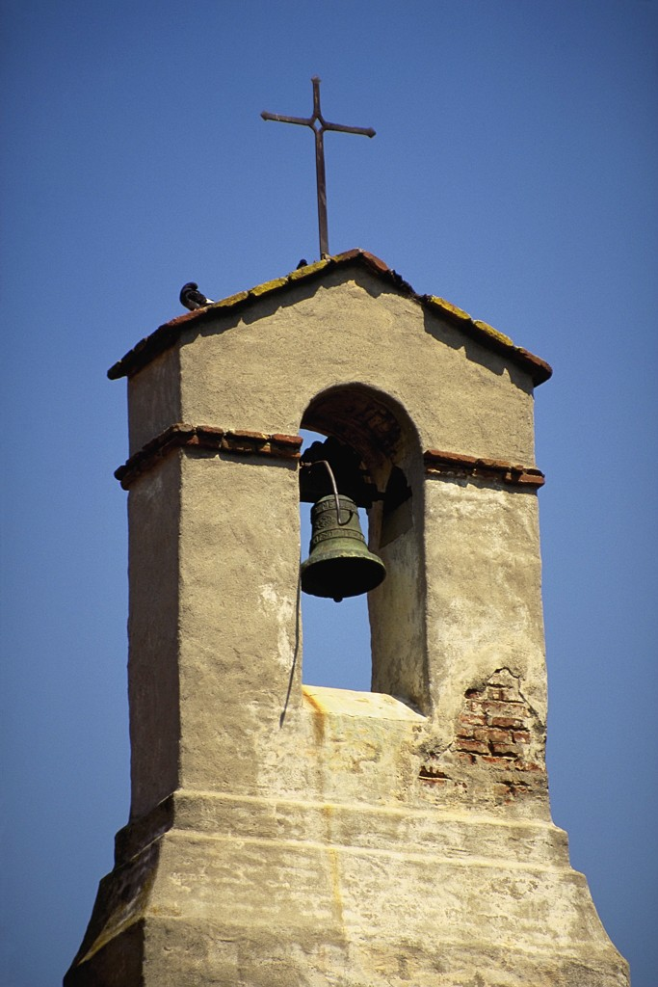
Spain takes strict control
use the system of encomienda – natives forced to work under brutal conditions similar to slavery
Christianity also was spread by missionaries
eventually, priests end encomienda, replace the workers with slaves from Africa
Spain became the richest country in the world due to their colonies and exports (gold, silver, sugar)

Slide 17
Cycle of Conquest & Colonization
Explorers
Conquistadores
Official
European
Colony!
Missionaries
Permanent
Settlers

Slide 18
New social structure created
1. Peninsulares – (people from the peninsula) – born in Europe
2. Creoles – born in the Americas but their ancestors were from Europe
3. Mestizos – mixed Native American and European people
3. Mulattoes – mixed African and European people
4. Native Americans
4. Africans

Slide 19
The Colonial Class System
Peninsulares
Creoles
Mestizos
Mulattos
Native Indians
Black Slaves

Slide 20
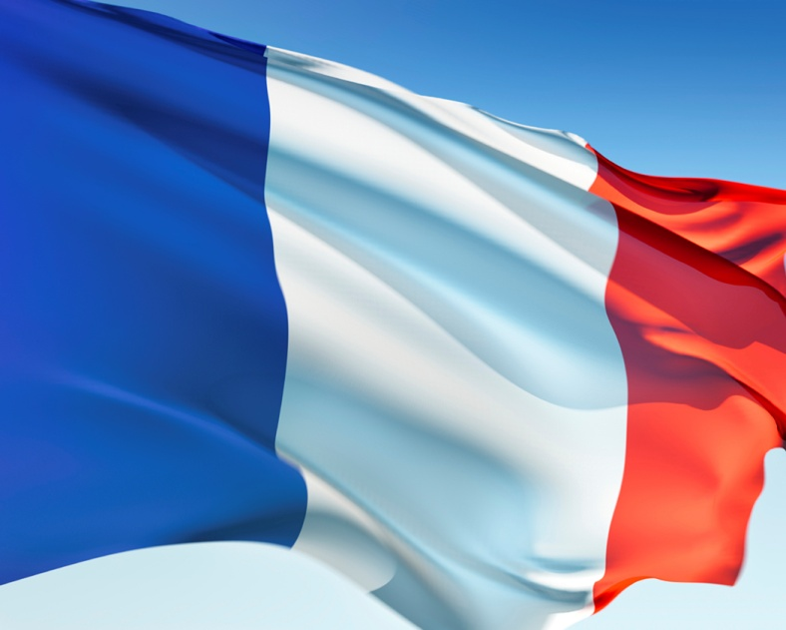
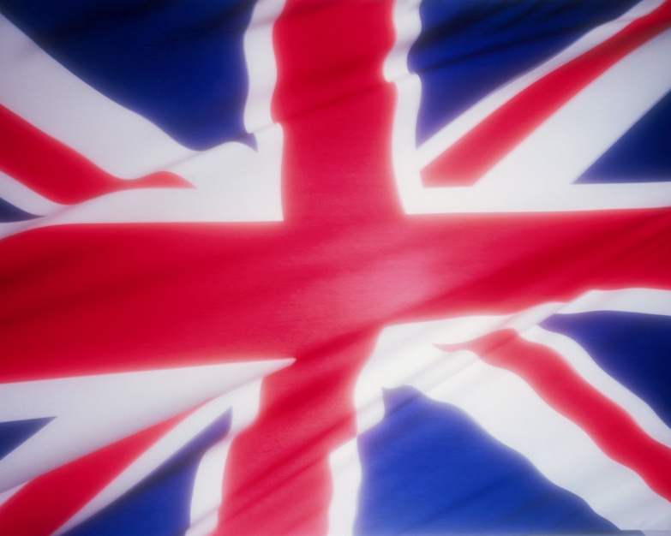
Section 3 Pg. 482
vs.
North American Colonies

Slide 21
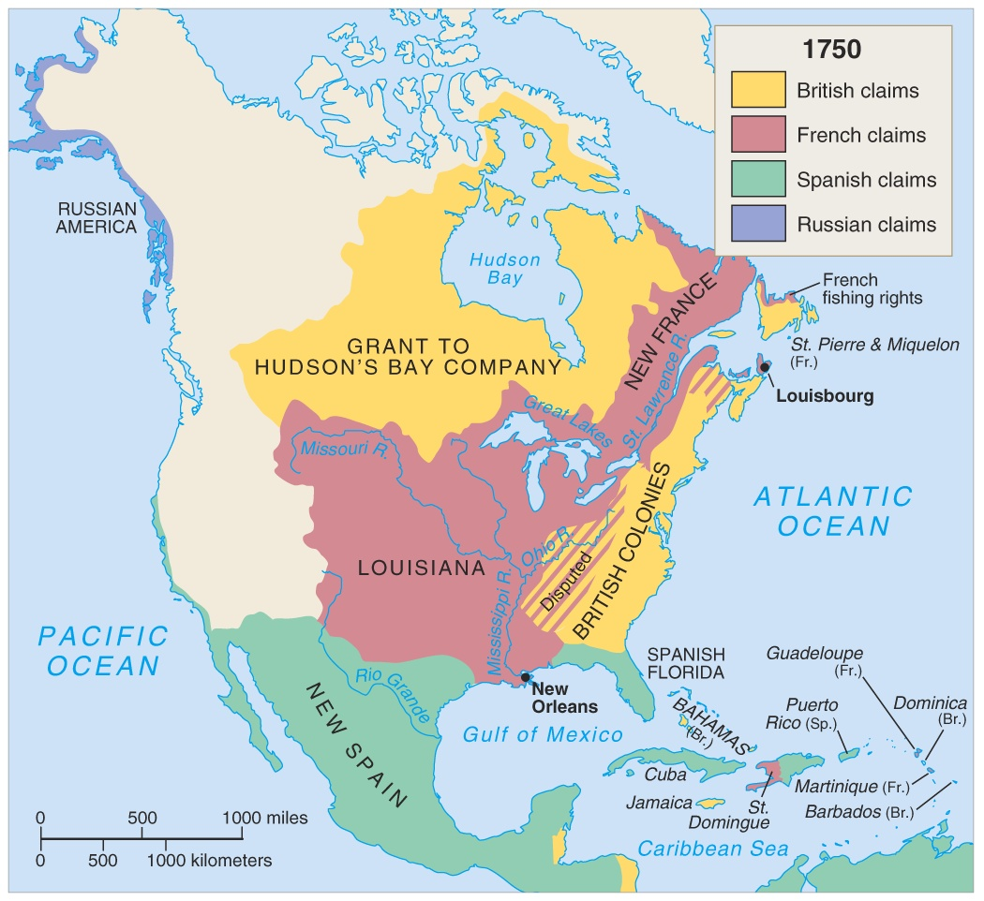
North America in 1750

Slide 22
France and england claim land
France settles in Canada, trades furs with Native Americans
England settled the east coast of the U.S. (13 colonies)
first colony was Jamestown, VA (1607)
grew cash crops (tobacco) and imported slaves for workers also

Slide 23
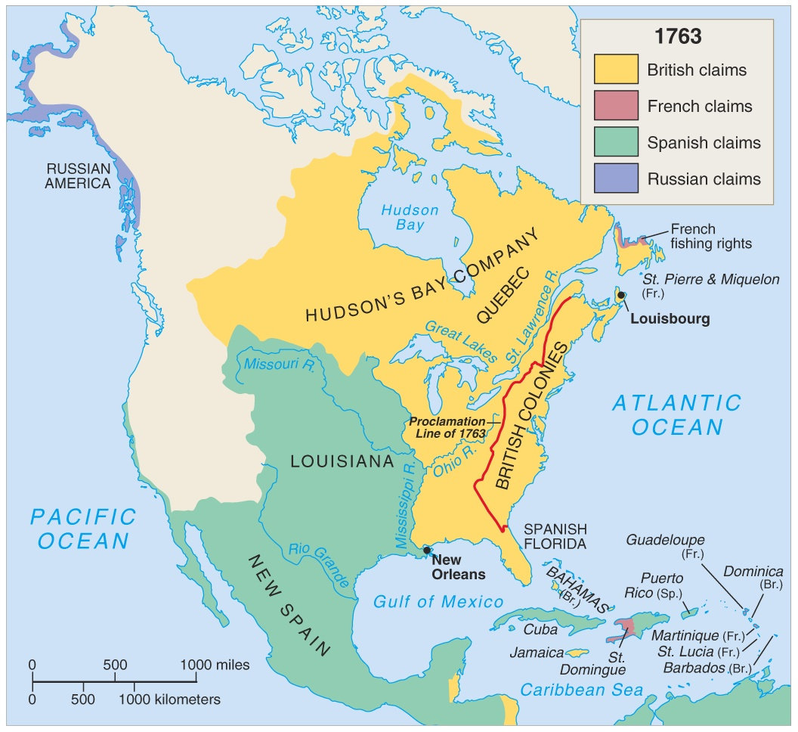
The french and indian war (Seven Years’ War)
both countries territories were growing and they are competing for the same land
England wins and gets all of the land east of the Mississippi river

Slide 24
1763 → Treaty of Paris
France --> lost her Canadian possessions, most of her empire in India, and claims
to lands east of the Mississippi River.
Spain --> got all French lands west of the Mississippi River, New Orleans, but lost Florida to England.
England --> got all French lands in Canada, exclusive rights to Caribbean slave trade, and commercial dominance
in India.

Slide 25
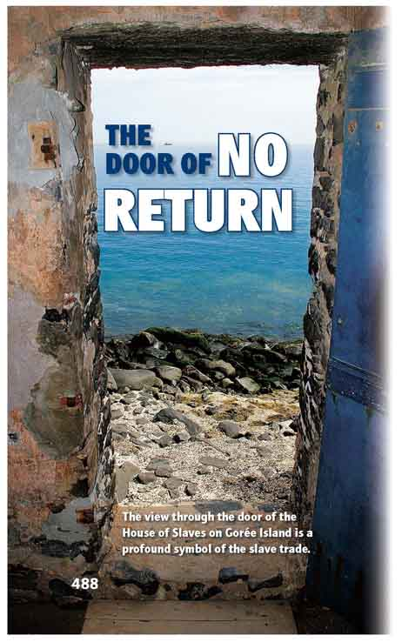
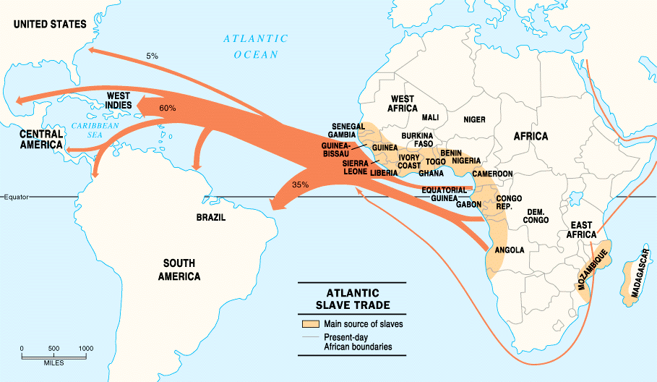
Section 4 Pg. 487
The Atlantic Slave Trade

Slide 26
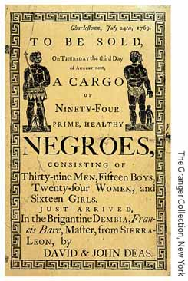
The Slave Trade
-Existed in Africa before the coming of the Europeans.
-used to grow crops like sugar, tobacco, rice and cotton on plantations.
-First boatload of African slaves brought by the Spanish in 1518.
-about 10 million Africans shipped to the Americas.

Slide 27
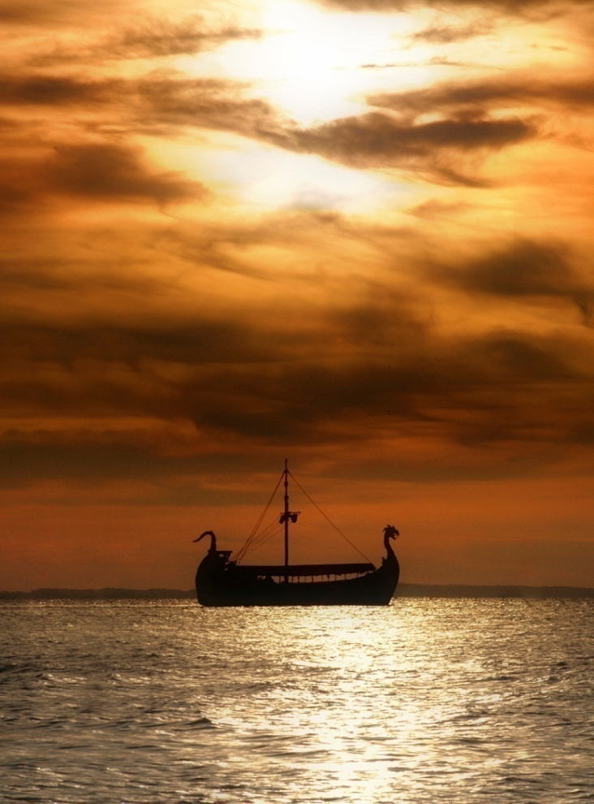
Triangular trade
1. Europeans trade goods for slaves in Africa
2. Slaves brought to America and sold
3. Merchants buy tobacco/sugar/coffee to sell to Europe

Slide 28
The middle passage
journey from Africa to the new world on slave ships
slaves were bought or sometimes captured
long and dangerous journey (up to 3 months)
crowded and cramped
many died from disease, mistreatment or suicide

Slide 29
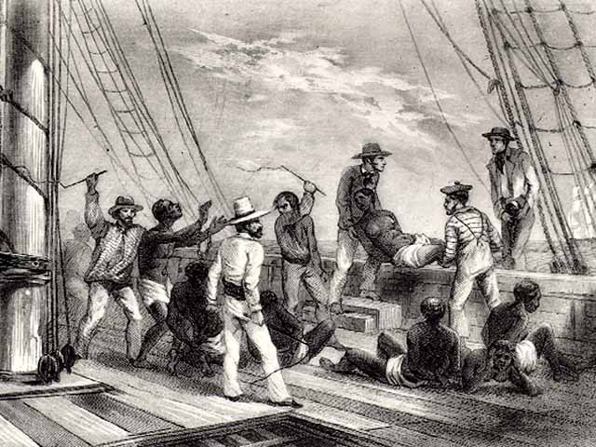
African Captives
Thrown Overboard
Sharks followed the slave ships!

Slide 30
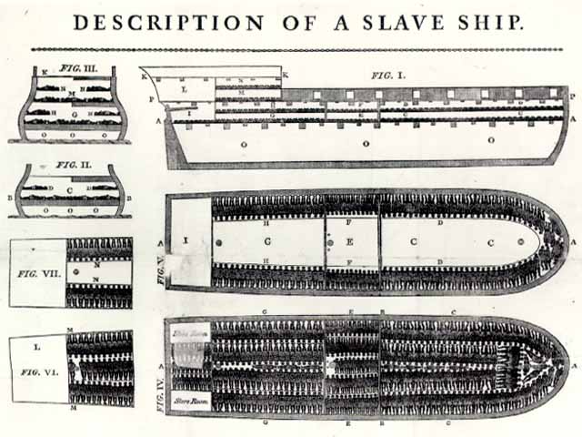
Slave Ship
“Middle Passage”

Slide 31
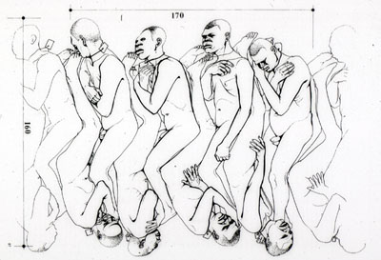
“Coffin” Position Below Deck

Slide 32
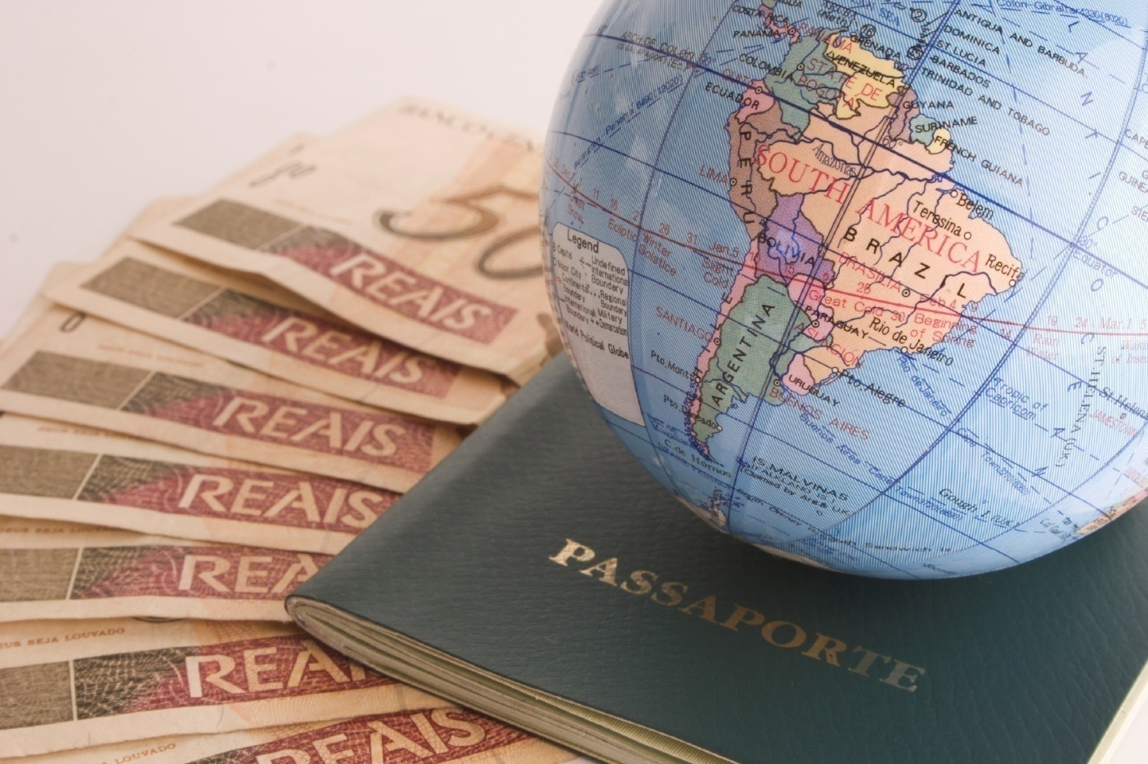
Global Exchange Page 491
Section 5

Slide 33
Columbian Exchange
transfer of goods to and from the Americas
Europeans get: new healthy crops (corn, potatoes).
Allows population to grow
Americas get : livestock (including horses) and disease.
Native population decreases by about 90%
massive immigration to the Americas also occurs
-opportunities for wealth and a new life

Slide 34
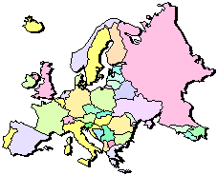
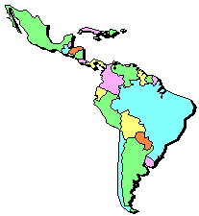
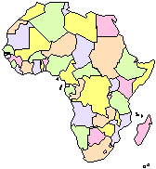
The “Columbian Exchange”
Squash | Avocado | Peppers | Sweet Potatoes
Turkey | Pumpkin | Tobacco | Quinine
Cocoa | Pineapple | Cassava | POTATO
Peanut | TOMATO | Vanilla | MAIZE
 | Syphilis
Trinkets
Liquor
GUNS
Olive | COFFEE BEAN | Banana | Rice
Onion | Turnip | Honeybee | Barley
Grape | Peach | SUGAR CANE | Oats
Citrus Fruits | Pear | Wheat | HORSE
Cattle | Sheep | Pigs | Smallpox
Flu | Typhus | Measles | Malaria
Diptheria | Whooping Cough

Slide 35
new business practices occur
merchants try to maximize their profits
Joint-stock companies – groups of people sharing the costs and profits of a business
Entrepreneurs – people who start and organize a business
Mercantilism – idea of exporting (selling) more than you import (buy)

Slide 36

Mercantilism
The economy and trade
are essential to the health
and safety of the nation.
Get as much gold and silver
as you can
Establish a favorable balance
of trade
Get colonies

Slide 37

Columbian Exchange Video
4:59

