Slide 1
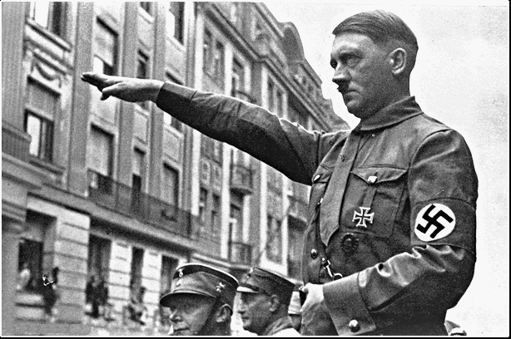
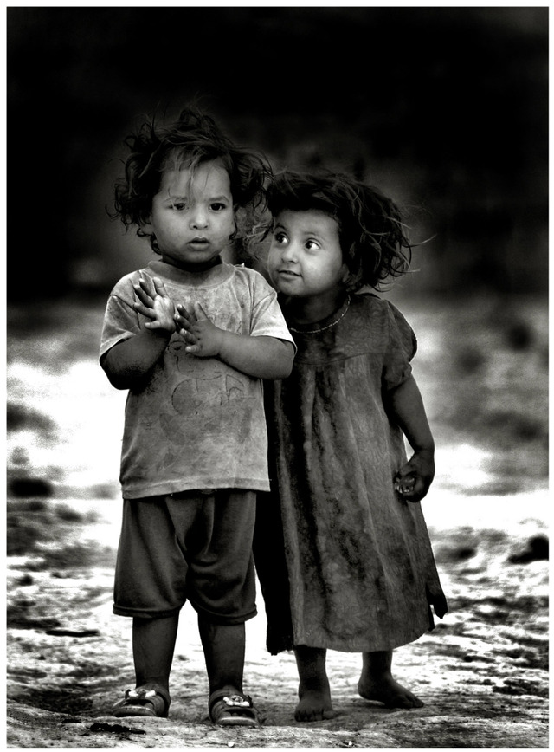

Chapter 28 The World Between Wars
Section 1 Page 884
Postwar Social Changes

Slide 2
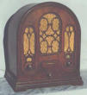
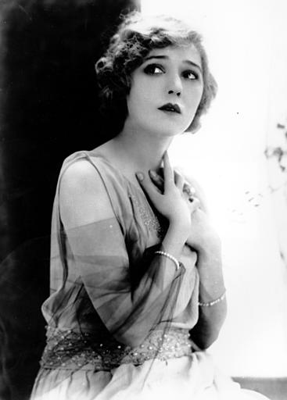
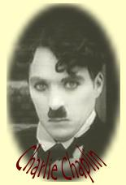
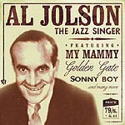
Social Changes
Mass culture shared worldwide
Due to better transportation and communication
Many younger people reject old fashioned lifestyle
Leads to the “Roaring Twenties”

Slide 3
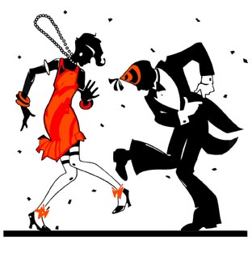
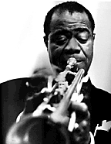
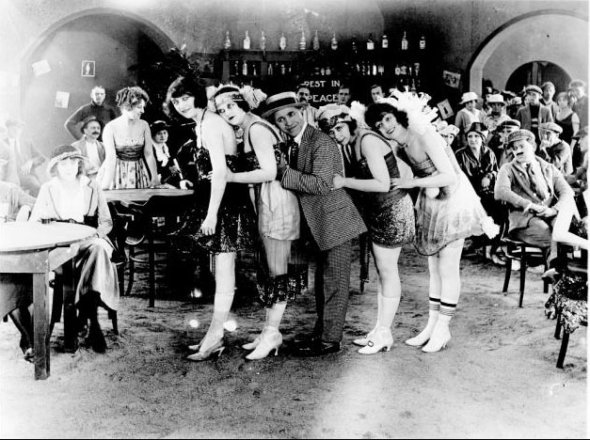




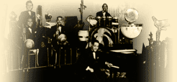
The 20’s is The Jazz Age
The Flappers
-make up
-cigarettes
-short skirts
Writers
F. Scott Fitzgerald
Ernest Hemingway
Musicians
Louis Armstrong
Duke Ellington

Slide 4
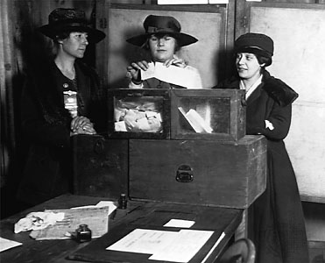
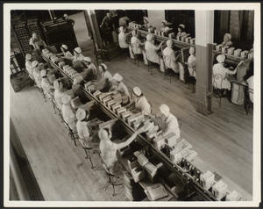

CHANGES FOR WOMEN
1920 - 19th Amendment gave them suffrage
more women worked outside the home
more women went to college and tried to join new professions
women didn't want to sacrifice wartime gains - amounted to a social revolt
characterized by the FLAPPER/ "new woman"
  (bobbed hair, short dresses, smoked in public...)

Slide 5
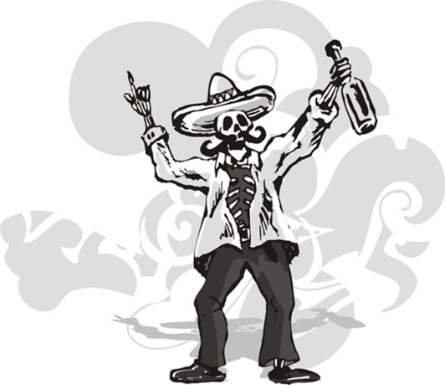
Prohibition
Law that made alcohol illegal (18th Amendment)
Supposed to protect people from negative effects of drinking
Instead it lead to organized crime and illegal bars called speakeasies
Repealed (taken away) in 1933

Slide 6
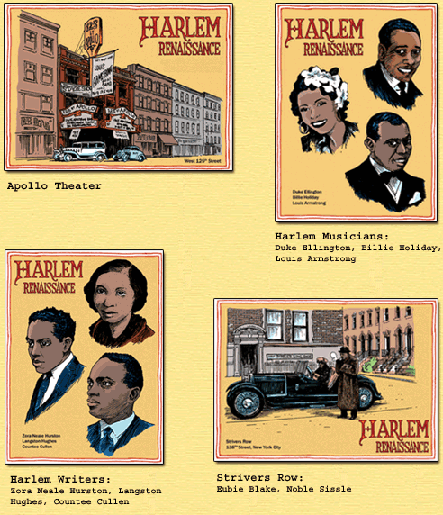

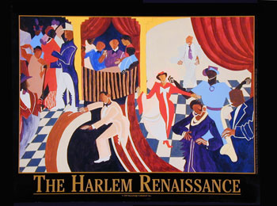
A Time of Progress
Many new scientific discoveries take place (psychology, medicine, chemistry and physics)
New literature (focus on war novels, poetry and plays)
Harlem Renaissance – African American cultural awakening used to express pride through writing and art

Slide 7
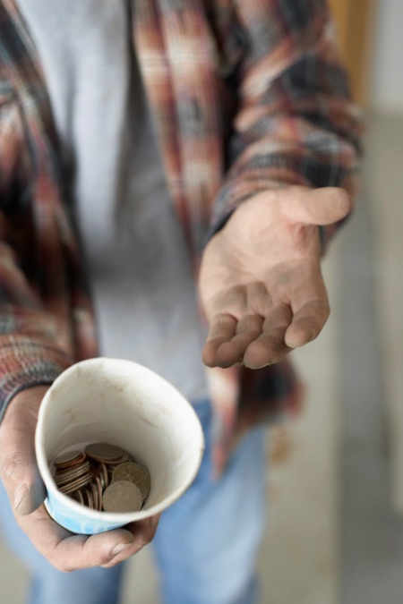

Section 2 Page 891
Postwar Depression and Economic Downturn

Slide 8

Most of Europe was in crisis after WWI
Economic rebuilding was needed
Many countries were bankrupt
U.S. was in an economic boom however
Not as affected by the war

Slide 9
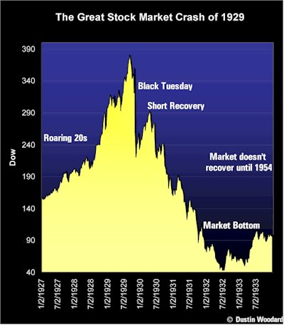
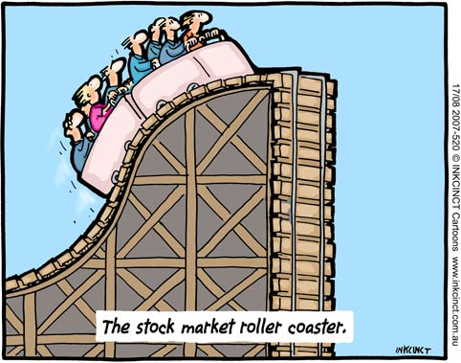
The Great Depression
Page 895

Slide 10


Attempts at Peace
Kellogg-Briand Pact – an agreement to disarm countries and reduce their military
League of Nations – group of countries agreeing to work together for peace
-no military or way to enforce rules though
-some countries left out also

Slide 11


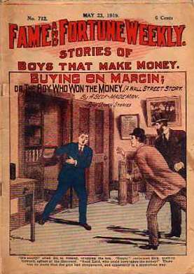
Reasons for the Depression
1. Overproduction
2. people bought stocks on margin
U.S. produced massive amounts of consumer goods
60% of families made
< $2000/yr.
too poor to buy these goods
businesses can’t sell their products, cut back on production and workers laid off
borrowing money from a stockbroker to pay for a stock
works well when stocks go up
if stocks go down, you go in debt

Slide 12
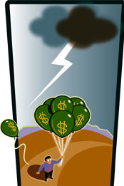
Depression Begins
businesses fail
banks go out of business
people lose all of their money and jobs (25% unemployed)
affects the whole world (limited trade)
1929- investors begin to sell stocks rapidly
-nobody wants to buy and stock prices go down
Black Tuesday – stock market crashes

Slide 13
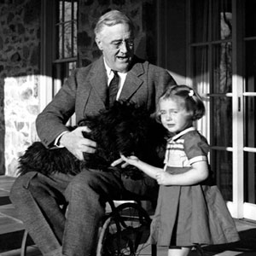
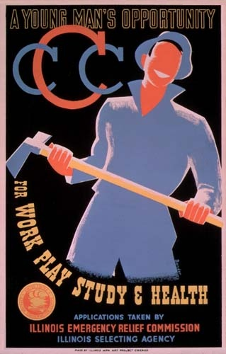
The New Deal
president Franklin D. Roosevelt’s plan to get out of the Great Depression
programs to give people jobs
helps banks
welfare and relief programs
doesn’t end depression but helps

Slide 14
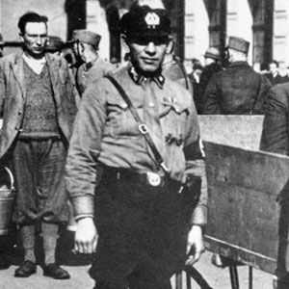
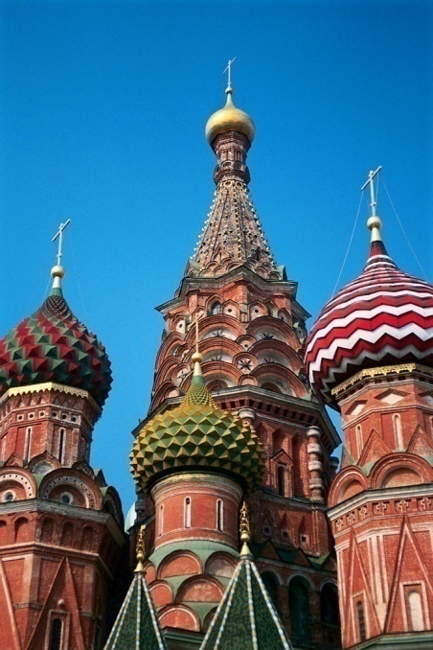
Section 3 and 4
Fascism
p. 898

Slide 15
Fascism
-political movement emphasizing military force and loyalty to a country and leader.
-extreme nationalism
-ruled by dictators, no democracy or individual rights
-everything done for the country
-many wore uniforms to show unity
-Used in Italy by Benito Mussolini
-promised to revive economy
-had secret police
-media restricted to only Fascist topics
-creates a totalitarian state
(dictator tries to control everything in citizens lives)

Slide 16
Fascism also used in the Soviet Union (Russia)
-Led by Joseph Stalin
-government made all important decisions about economy
-used terrorism/threats to maintain control
-starved his own people
-took away individual rights
-limited freedoms

Slide 17

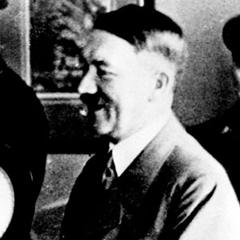
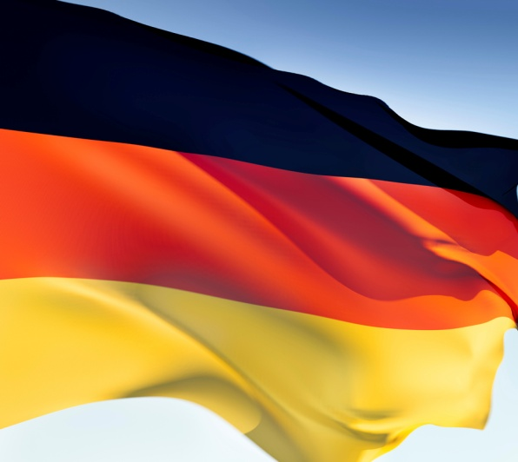
Section 5 page 912
Hitler and the Rise of Germany
Elevation!

Slide 18
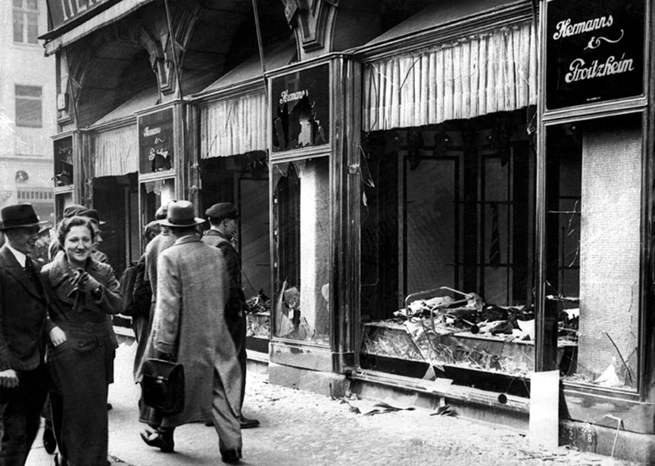
Adolf Hitler
fought in WWI for Germany
Nazism - German fascism
wanted to overturn Treaty of Versailles
called the Fuhrer (leader)
wrote Mein Kampf (My Struggle) telling his beliefs and goals for Germany
believed Aryans were the ‘master race’
everyone else was inferior, especially Jews, Blacks, handicapped, homosexuals
Kristallnacht (Night of the Broken Glass) - Jewish homes and businesses burned and destroyed by Nazis
wanted Lebensraum - living space for Germans, needed more land

Slide 19
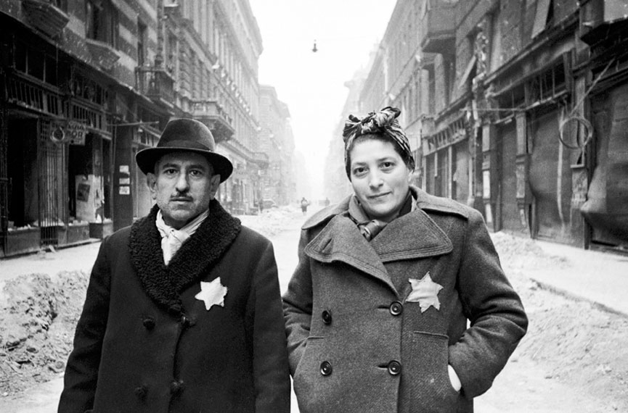
Hitler takes over
-comes to power in 1933
-created the SS - group loyal to Hitler that arrested and killed enemies
-Gestapo - secret police that used brutal tactics and terrorism to scare people into obedience
-people were afraid to defy Hitler
-everyone had to be a Nazi or risk persecution

Slide 20
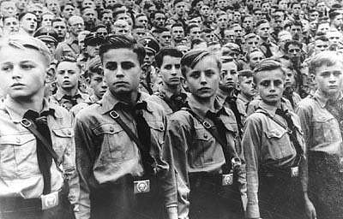
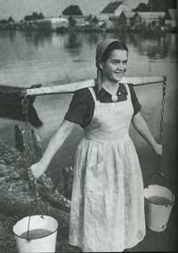
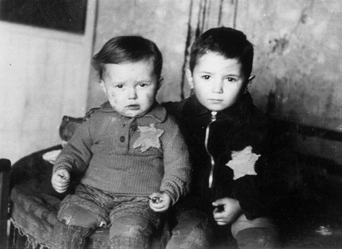
Purifying German Culture
-limited religious freedom, art and music
-Hitler youth and other groups for children were formed to try and provide for the future
-Women were to be used for birthing pure-blooded Aryan babies, most not allowed to work outside the home
-persecution of Jews begins with Nuremberg Laws (couldn’t go to school, get government jobs, write books, identified by wearing yellow stars)

