Slide 1
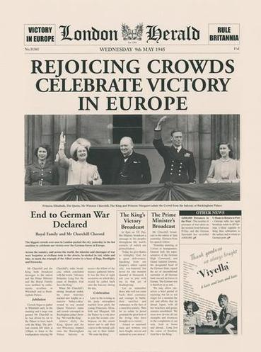
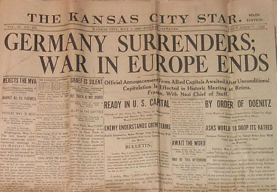
Victory for the Allies
Section 4 Page 948

Slide 2
Nazis go down
Russian troops close in on Berlin as do Allies in the west
Hitler commits suicide
Germany finally defeated by the allies in May, 1945
ends war in Europe but still going on in Asia

Slide 3
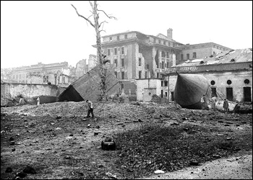
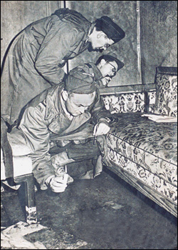
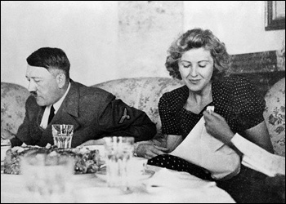
Hitler Commits Suicide April 30, 1945
Cyanide & Pistols
The Führer’s Bunker
Mr. & Mrs. Hitler

Slide 4
War in the Pacific continues
-Japan already weakened by U.S. and allied bombing
-Atomic bombs dropped on Hiroshima and Nagasaki
-Japan forced to surrender also, World War II ends

Slide 5
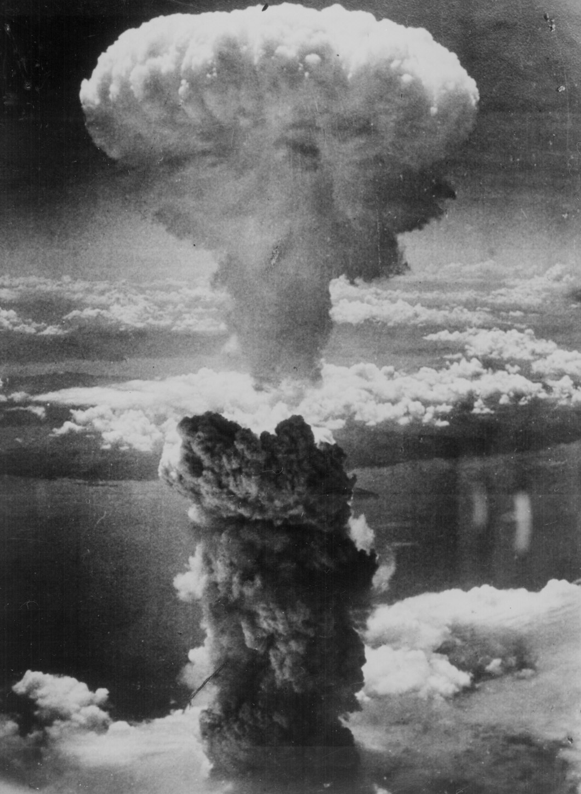
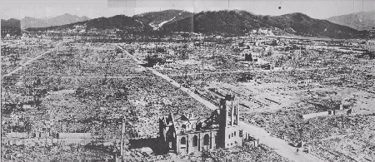
Hiroshima – August 6, 1945
70,000 killed immediately.
48,000 buildings. destroyed.
100,000s died of radiation poisoning & cancer later.

Slide 6
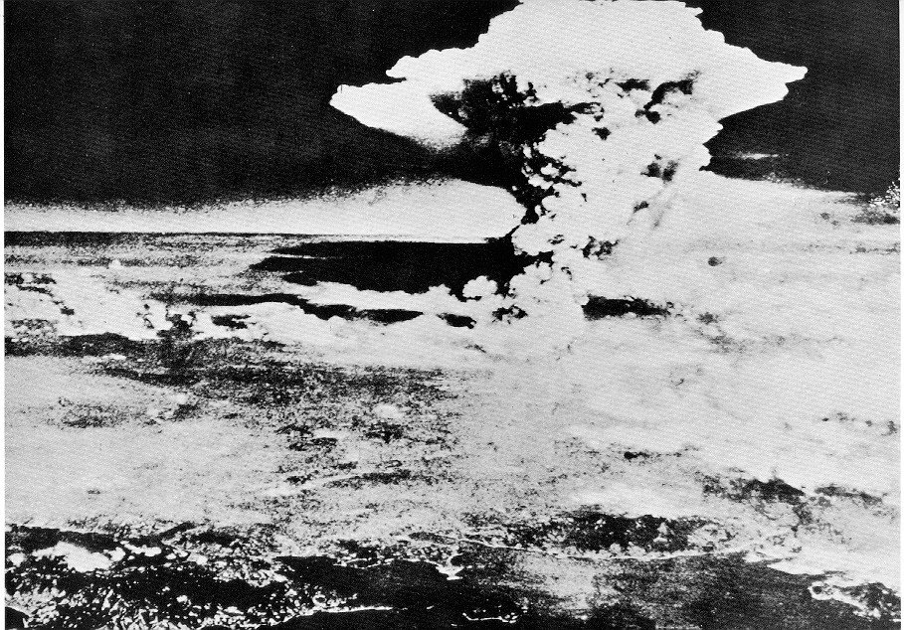
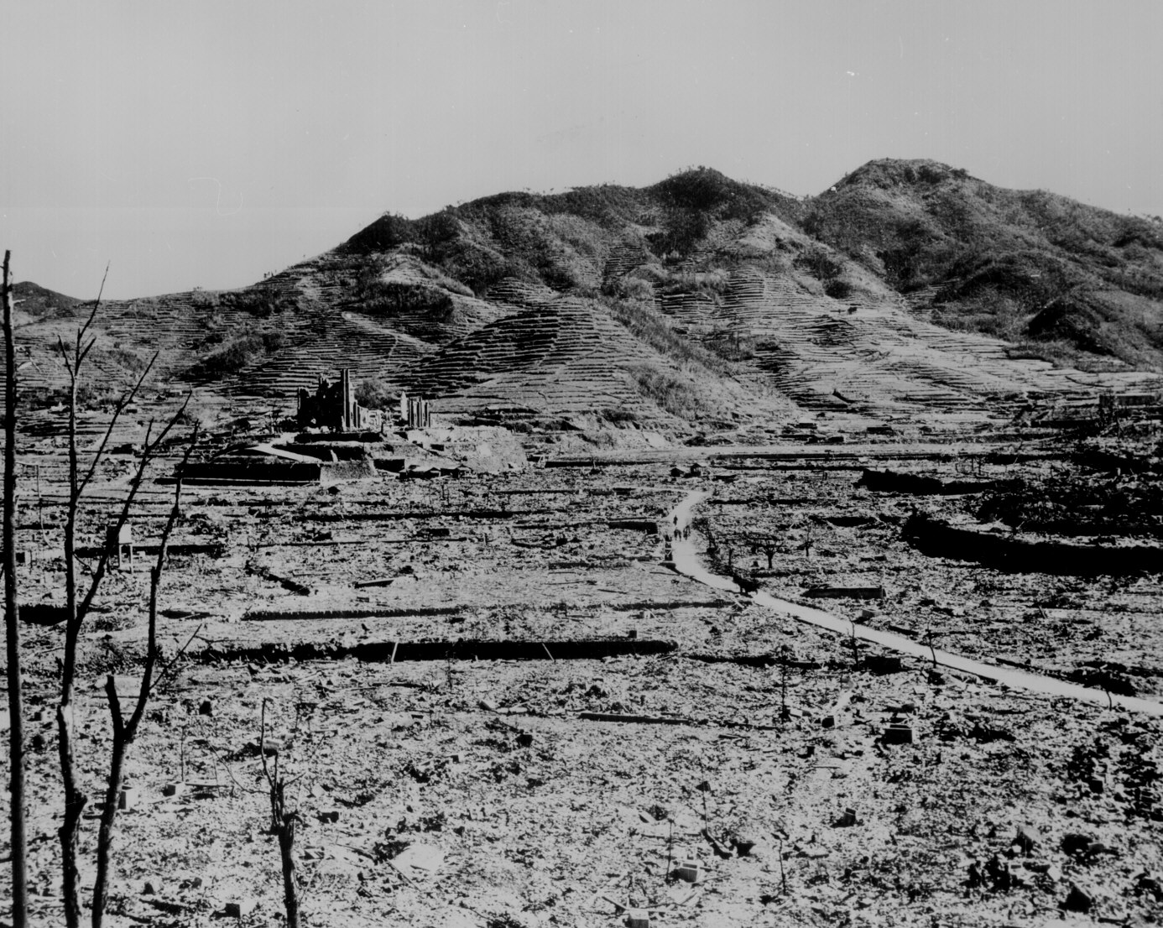
Nagasaki – August 9, 1945
40,000 killed immediately.
60,000 injured.
100,000s died of radiation poisoning & cancer later.

