Slide 1

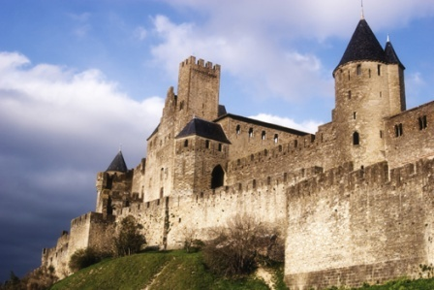

Chapter 8
The Late Middle Ages
P. 242

Slide 2
Conflicts in England
King Edward of England dies without an heir to the throne
arguments about who the next king should be
William the Conqueror from France takes over (1066)
efficiently managed land
made citizens swear allegiance to him instead of local nobles
took a census (count of the population) and collected taxes using the Domesday Book

Slide 3

King Henry II takes over (1154)
creates common law – law based on customs and court rulings, law
for everyone in England was now the same
-conflicts with church law however
-old feudal system started to break down

Slide 4

King John (Henry’s son)
was not a popular ruler
upset clergy members and his nobles
lost land to France and increased taxes
eventually forced to sign the Magna Carta (1215)
1. gave nobles rights (later leads to rights for all citizens)
2. king had to obey laws also
3. due process of law – guarantees fairness in legal proceedings
4. habeas corpus – can’t be imprisoned without being charged with a crime

Slide 5
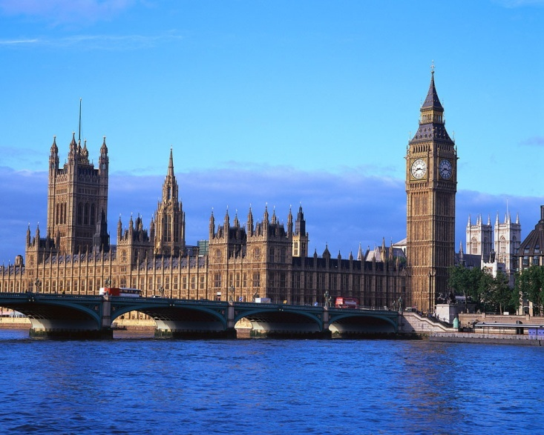
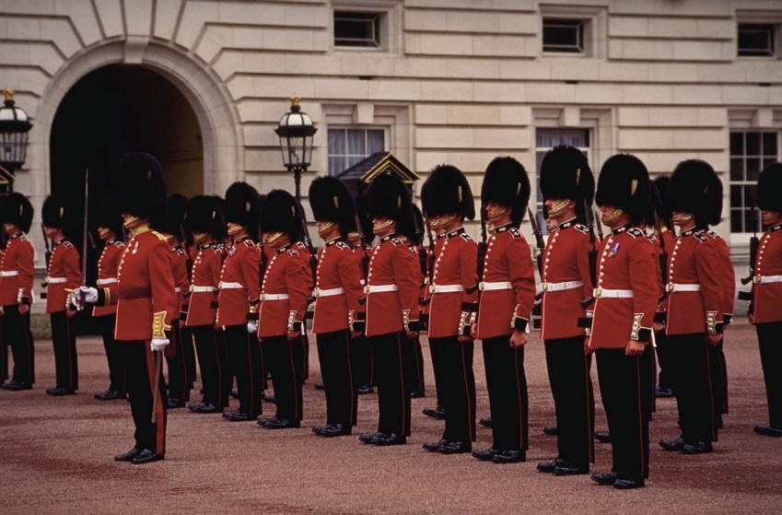
Parliament
lawmaking group in England (similar to U.S. Congress)
helped the king make laws, power to approve new taxes
split into two houses
1. House of Lords – made of nobles and clergy members
2. House of Commons – made of knights and middle class members

Slide 6

French rulers
Capetian dynasty (began by Hugh Capet) near Paris
organized government, Phillip II adds land and unifies France
Louis IX continues the dynasty
grandson, Philip IV, clashes with the pope over taxes
kidnaps the pope, names a new French pope
Catholic church names another pope
confusion is called the Great Schism (split) in the church
sets up Estates-General – lawmaking group made up of 3 groups
1. clergy 2. nobles (lords)
3. commoners

Slide 7
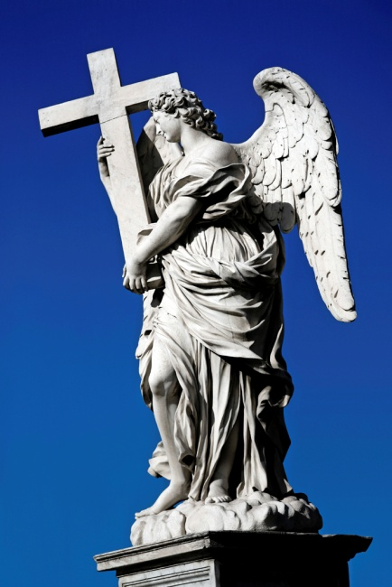

Section 2 The Holy Roman Empire
Page 251

Slide 8
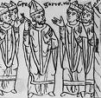
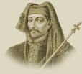
fights between popes and monarchs continue
Lay investiture
kings appointing church officials
pope Gregory VII bans this practice
King Henry IV refuses and says that it is his right to choose
pope excommunicates him
finally settled with the treaty Concordat of Worms
popes were more powerful than kings at this time

Slide 9
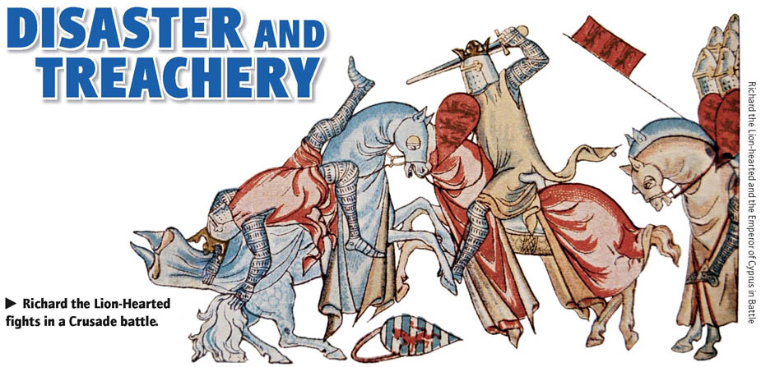
Section 3 Page 255
The Crusades

Slide 10


The Crusades
results
series of wars fought between Christians and Muslims over holy territory in the middle east
Pope Urban II calls Christians to war
thousands of knights and average citizens (women too) went to fight
lasted over 200 years
1. largely unsuccessful, took over the land for a little while but Muslims still held power there
2. increased trade, changing to a money economy
3. kings gain power, pope had reduced power
4. Europeans realized there were other civilizations out there (leads to exploring)

Slide 11
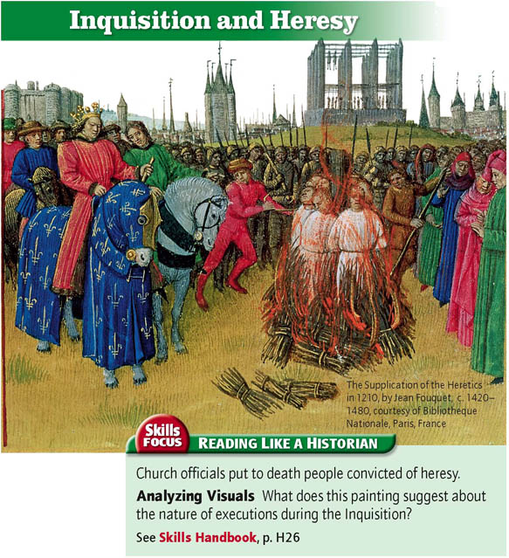
The Reconquista
(reconquer) the attempts to take back the land in Spain and Portugal (Iberian Peninsula) from the Muslims of Africa
no religious tolerance, Christianity was the only choice or you would have to face the:
Inquisition – church court set up to judge heretics (people going against church teachings)

Slide 12
Section 4 Page 262
The Growth of Knowledge and Culture

Slide 13

Universities built
church wanted educated people for clergy, kings needed smart people for government
for men only
some women were educated at home or private schools
-Many ancient ideas from Greece/Rome are rediscovered
-some ideas conflict with Christianity
-literature written in the vernacular – everyday, common language
-allows commoners to get information

Slide 14


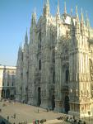

Architecture
-old style of Romanesque replaced by Gothic style
-emphasis on light using windows
-developed stained glass windows
-built great cathedrals

Slide 15

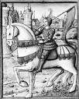
Section 5 Page 269
A Time of Crisis

Slide 16

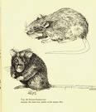
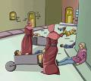
The Bubonic plague
great sickness that came from Asia
traders brought it back with them
spreads from person to person and by rats and fleas
disease was out of control, 25 million Europeans die
towns/trade decline
Jews blamed for the plague and are slaughtered

Slide 17


Slide 18
Hundred years’ War (1337-1453)
England vs. France
England wins early on using a new weapon, the longbow
France helped by Joan of Arc
teenager, claimed to hear voices from God and saints
leads French army to several victories
eventually executed for heresy – going against church beliefs
France also uses a new weapon, the cannon, to destroy castles and attack
after the war, castles and knights will no longer be used
larger armies needed

